Slide 1
Domain Driven Design
Technical Pattern

Slide 2
Les 3 perspectives d’un produit numérique
Business
Technologie
USAGE
Valeur

Slide 3
TACTIQUE
Ensemble de moyens coordonnés que l’emploie pour parvenir à un résultat
Art d’élaborer un plan d’actions coordonnées;
Plan d’actions coordonnées
STRATEGIC

Slide 4
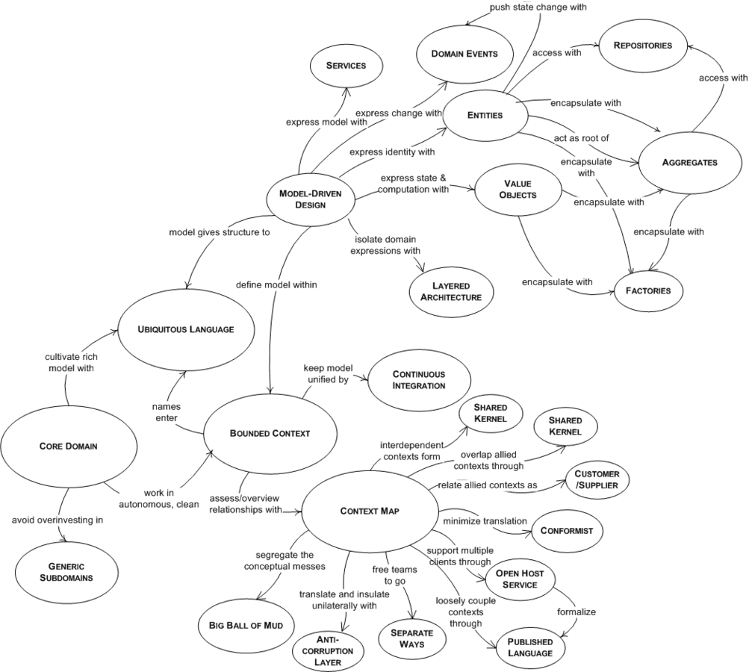
PATTERNS TACTIQUE
PATTERNS STRATEGICS

Slide 5
https://youtu.be/Evers5npkmE
DDD Strategic Patterns

Slide 6
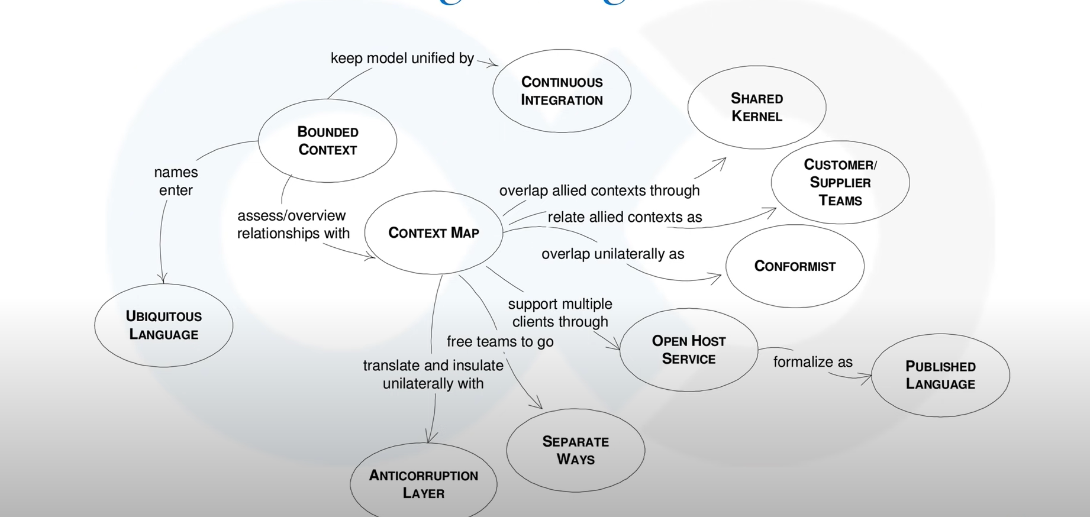

Slide 7
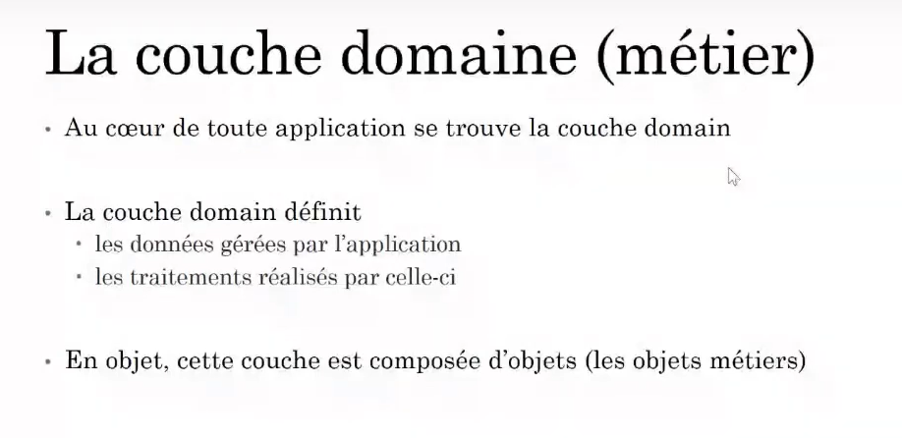

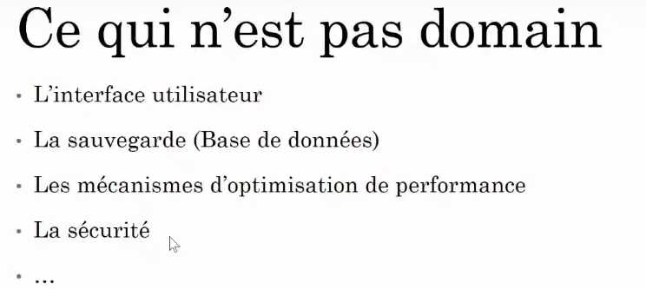
Le Domaine

Slide 8
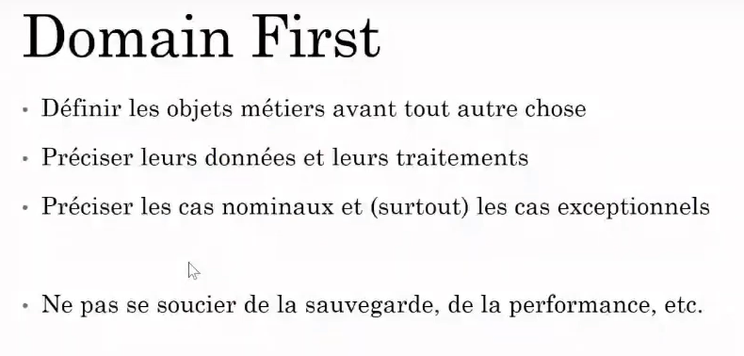
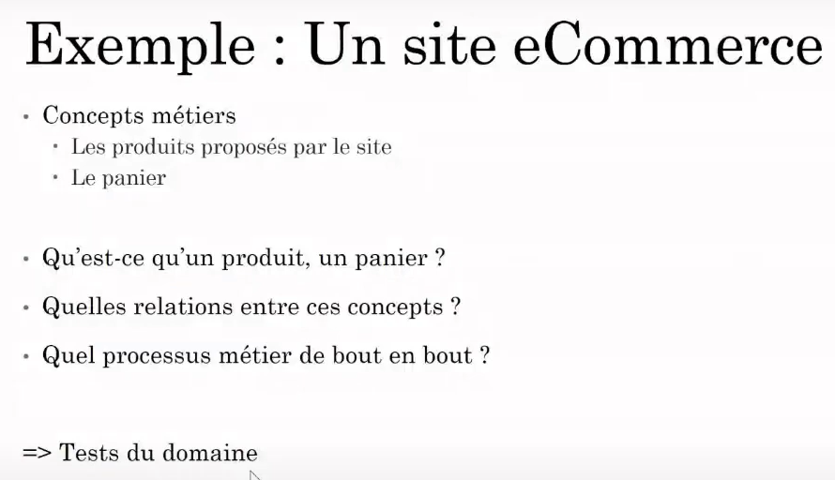
DD & Architecture hexagonale

Slide 9
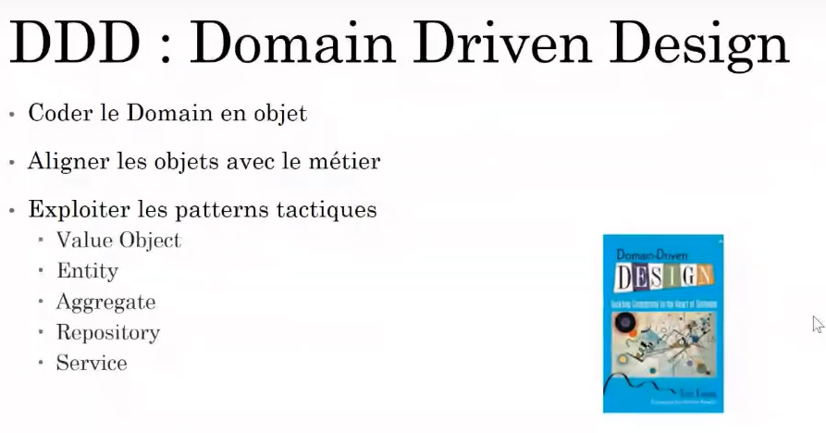
DD & Architecture hexagonale

Slide 10
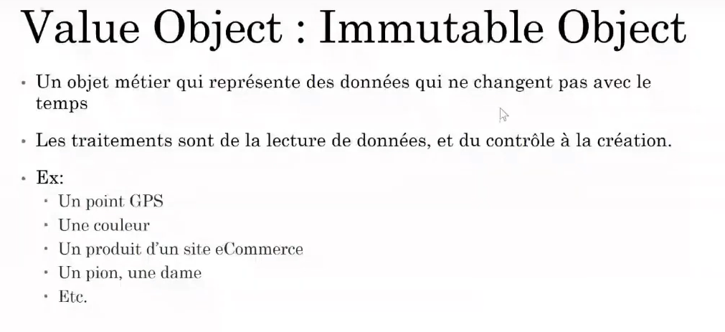
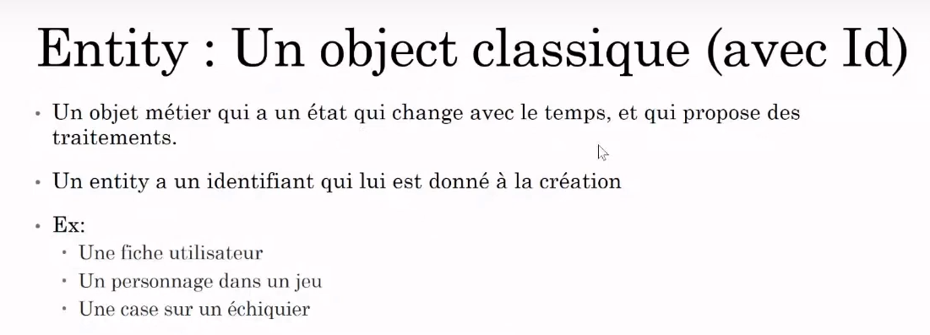
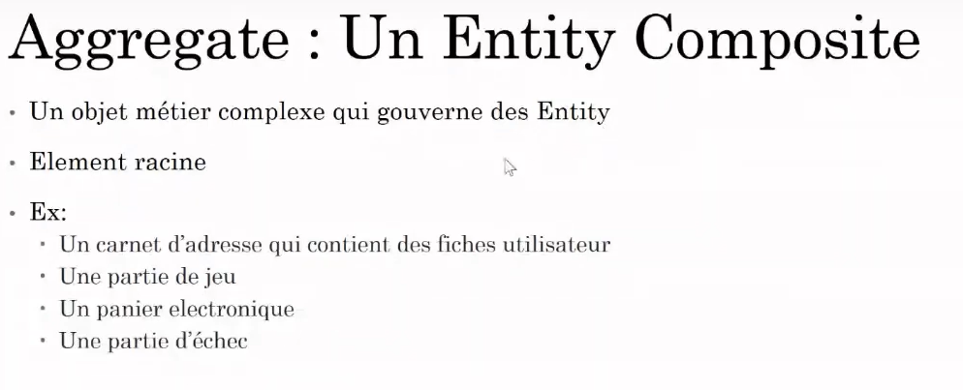
DD & Architecture hexagonale

Slide 11
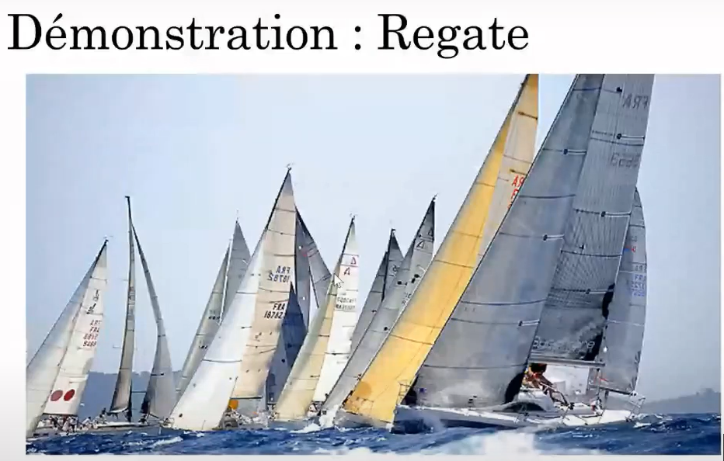
DD Démarche
Concepts
Patterns
Concepts
Patterns
Cap
1. Value Object
Boat
2. Aggregate
Reagate
3. Entity

Slide 12
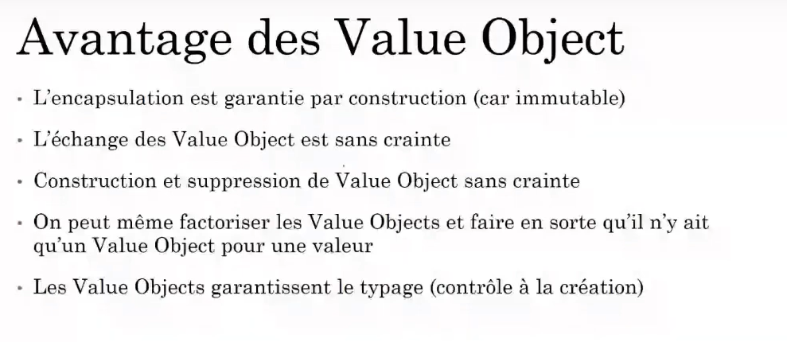
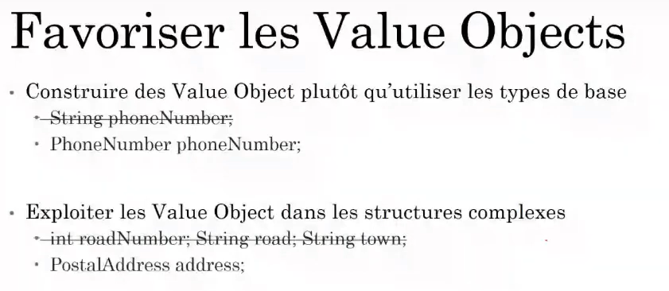
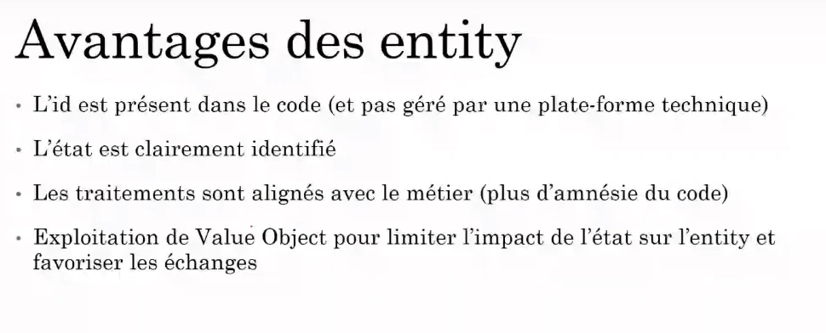
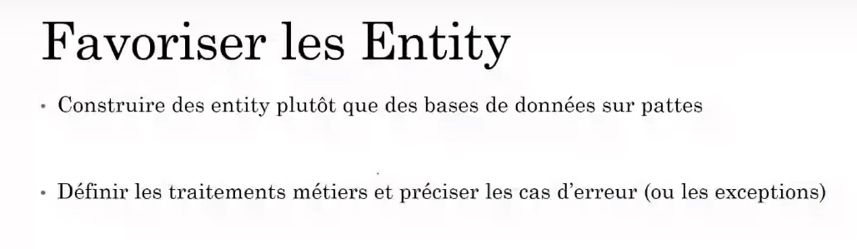
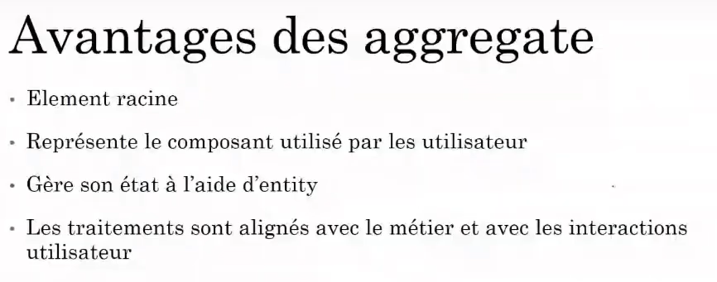
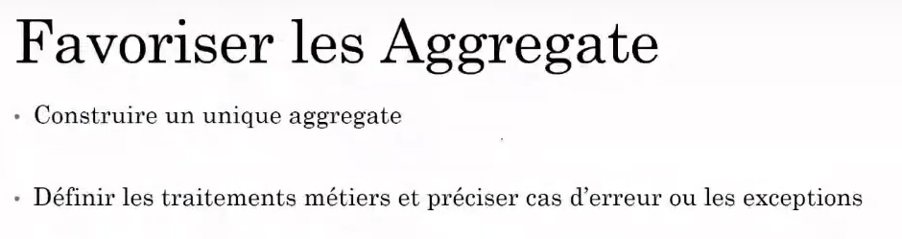
DD & Architecture hexagonale

Slide 13
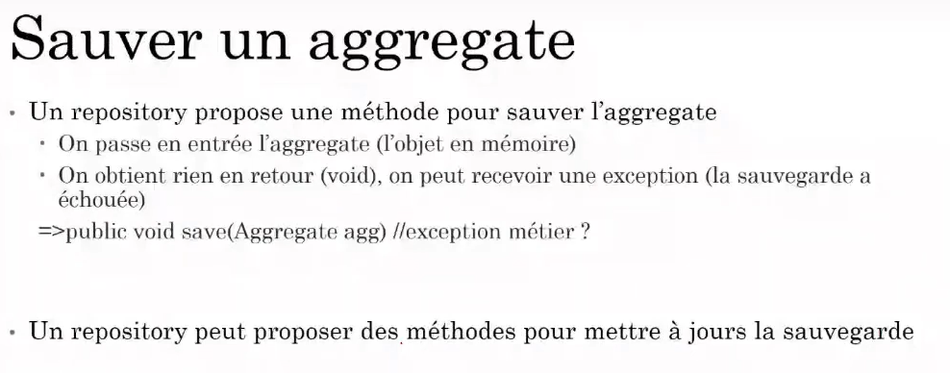
DDD Save an Aggregate

Slide 14
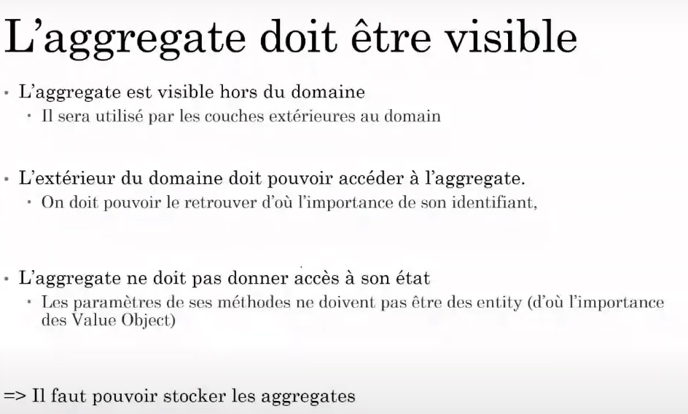
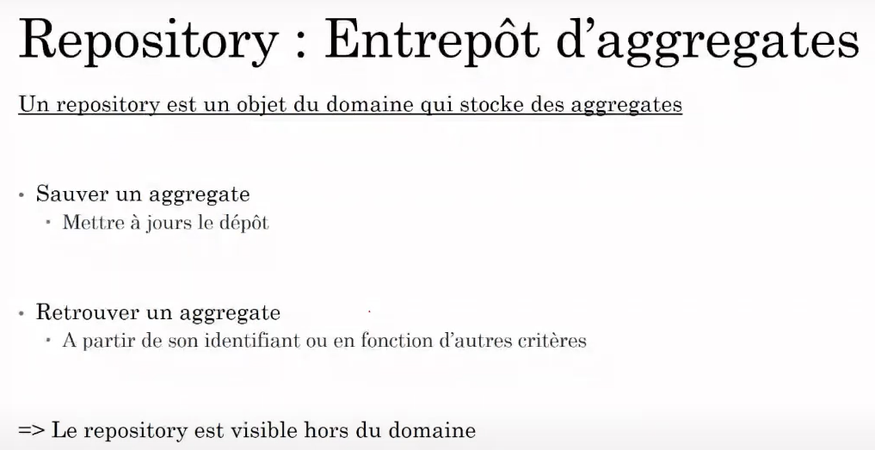
DDD Les aggregates et les Repositories

Slide 15
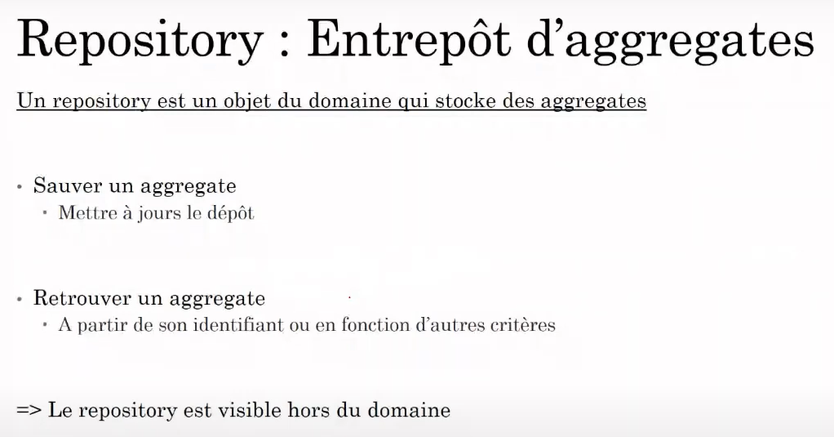
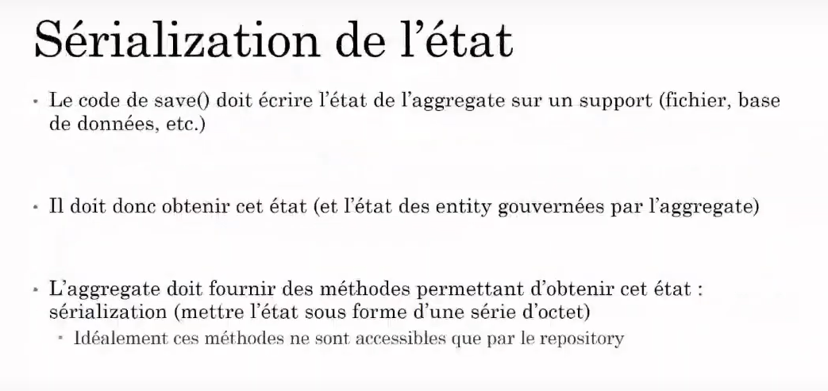
DDD Les aggregates et les Repositories
Notes:
https://www.youtube.com/watch?v=l1FvXGAmJWg

Slide 16
AGENDA
From Idea to implementation : 9 Steps
PLM Market overview
PLM Business Landscape
PLM OF FUTURE
FMS & The PLM
Q & A

Slide 17
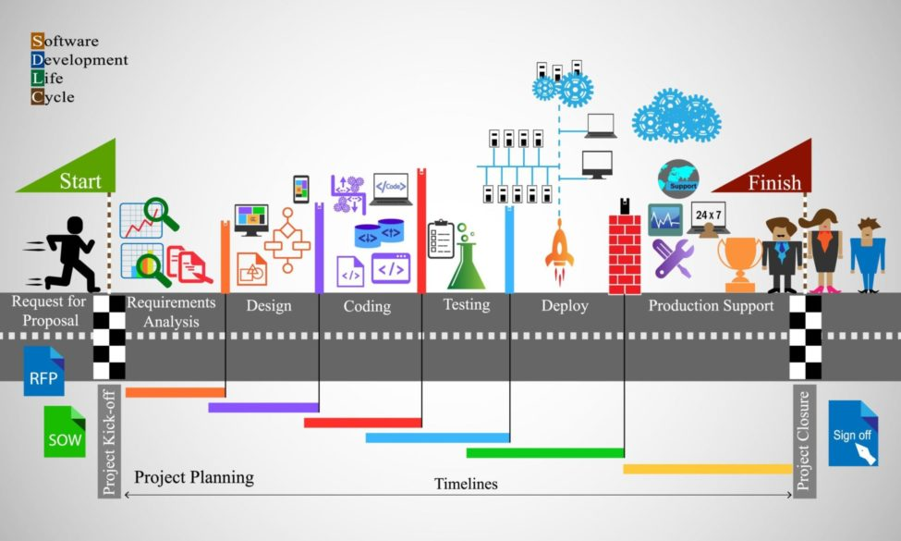
The 9 Steps
Brainstorm ideas
Plan & Analyse
Go through the Proof of Concept (PoC)
Design
Go through the Proof of Value (PoV)
Develop
Integrate
Deploy & keep a track
Maintain & Updgrade
Retirement
Notes:
https://baritechsol.com/blog/software-development-lifecycle/

Slide 18
The Idea
Needs identified from market
Idea to Solve a problem
R&D
Innovation process
Brilliant ideas lead to excellent products. But, ideas must receive a thorough evaluation before adoption. In addition to evaluation, establishing means to achieve company objectives, determining solutions, and selecting the project’s scope is all part of the planning phase of the software development or product development process. Here are a few more points that you can probe upon in this phase:Define your objectives
Make a list of the features that your software will have
Look into different software developments Brainstorm how you can make your product stand out
Discuss who your target audience is
Make a rough sketch of the software
Utilize your analytical skills to create a user story
Notes:
https://www.turing.com/blog/software-product-development-life-cycle/

Slide 19
Q & A

